Slide 1



TJTT Table Tennis Platform
Comprehensive platform for ping pong enthusiasts, providing convenient services for exchange, competition, and information.
by Charlie. BU

Slide 2
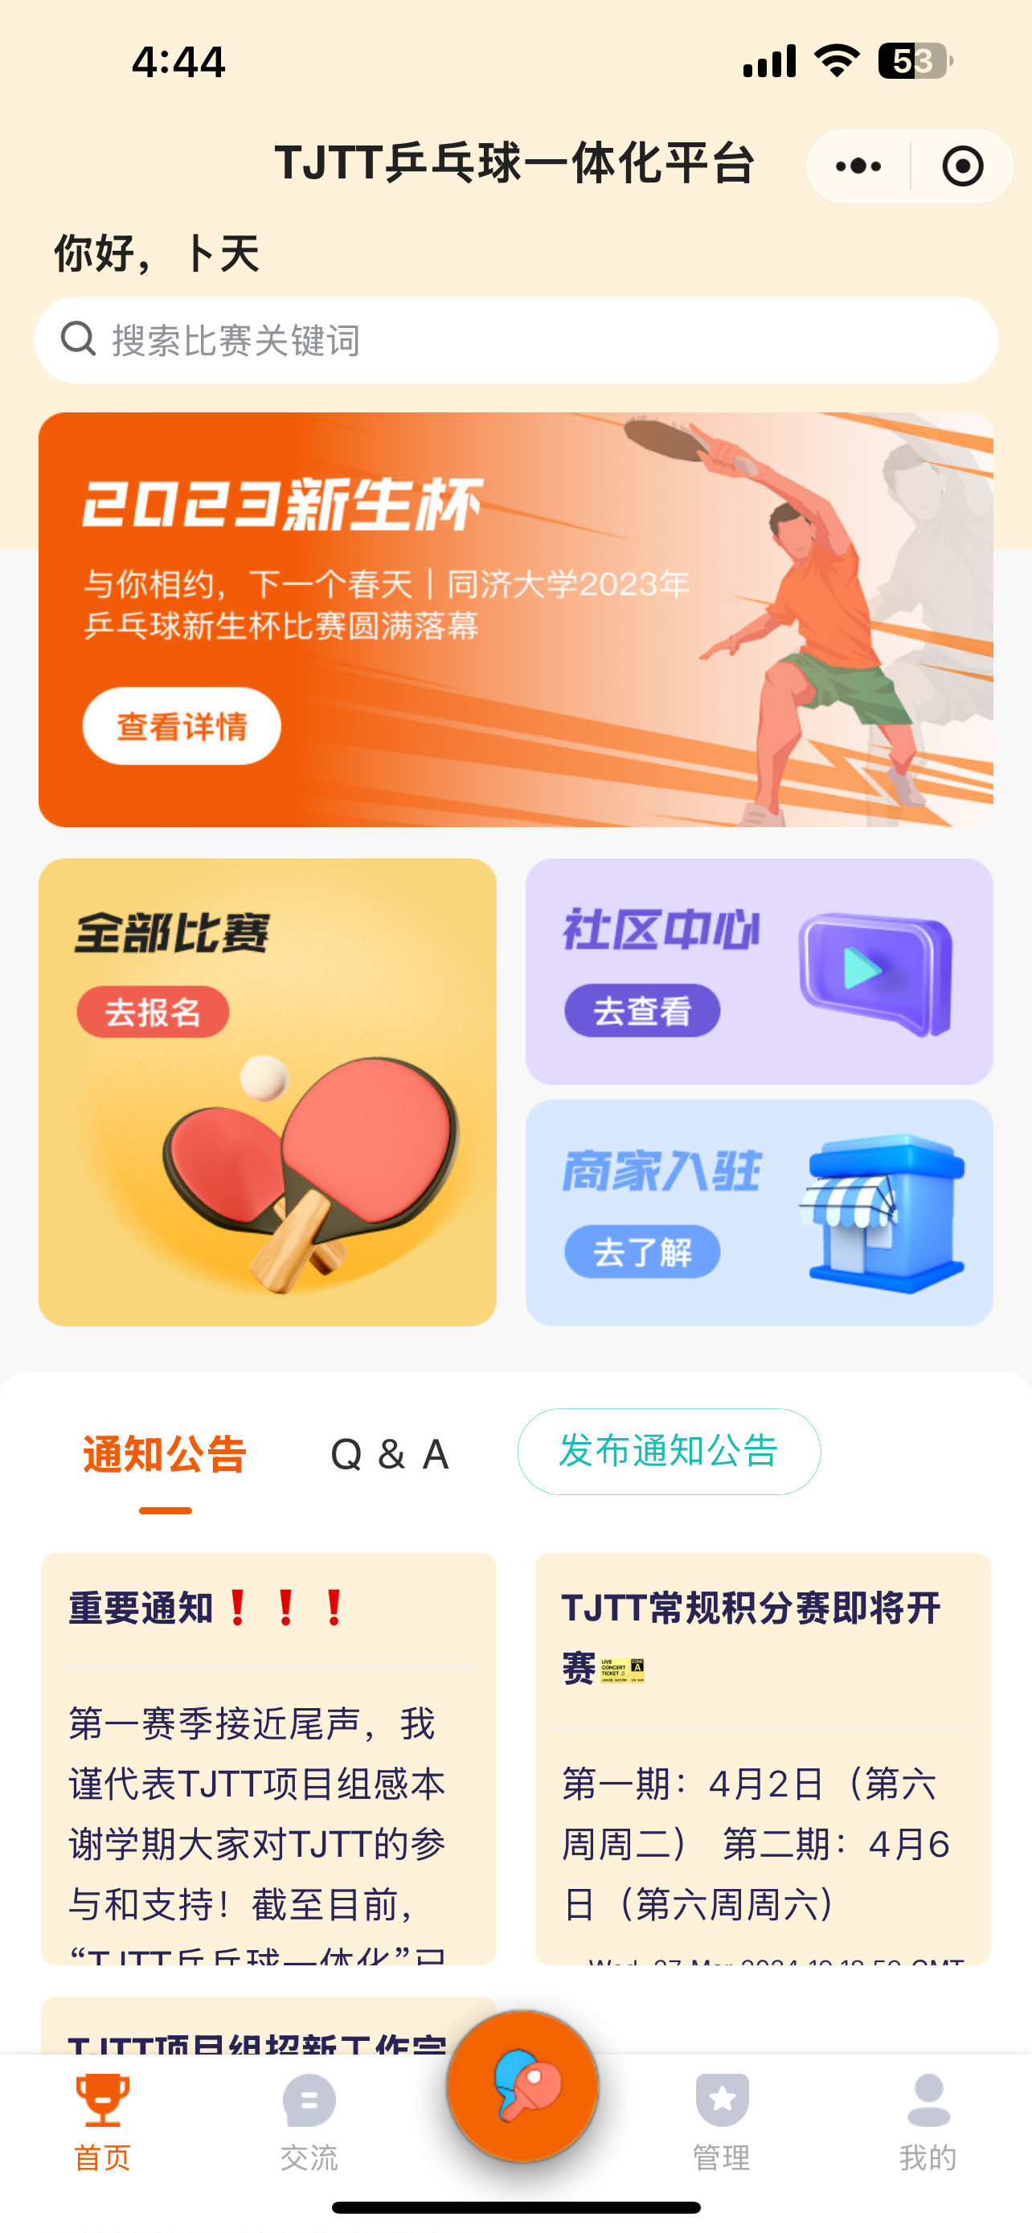

Convenient and User-Friendly
Intuitive Interface
Practical Features
Simple and straightforward design for easy registration, login, and management.
Meets diverse needs of ping pong players, with flexible management tools.
Unique Functions
Engaging features like match previews, Q&A, and more to enhance
user experience.

Slide 3
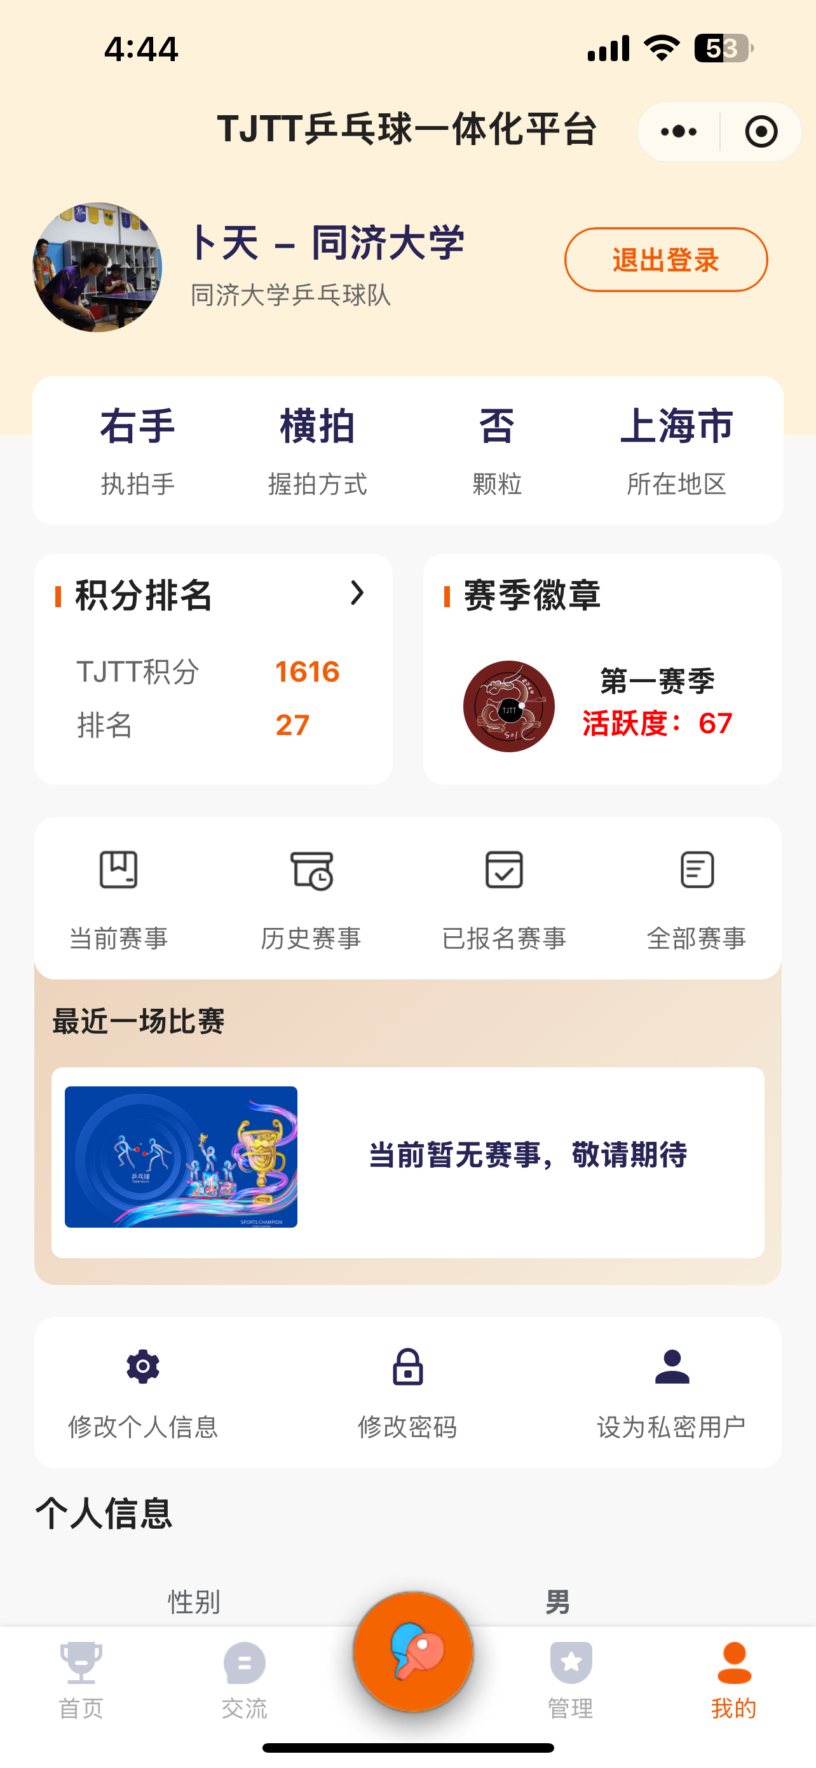
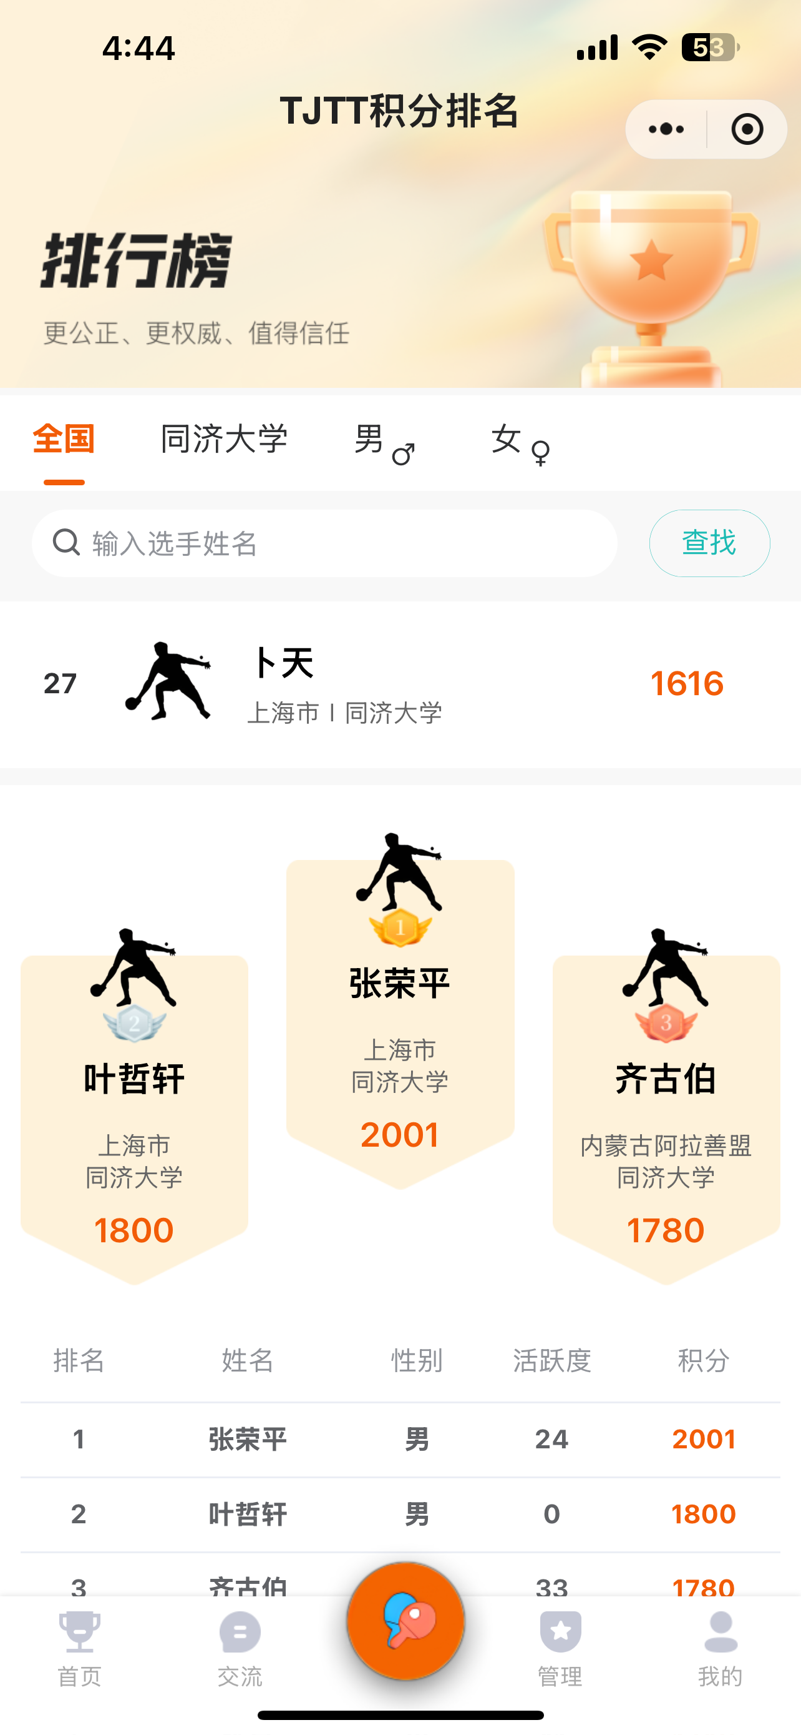
Comprehensive Functionality
User Profile
Ranking and Scoring
Information Hub
View your personal information, ping pong skills and attributes, and account management tools all in one place.
Stay up-to-date on national, university, and gender-based rankings and scores to track your progress.
Access announcements, Q&A, and other valuable ping pong-related content and updates.

Slide 4
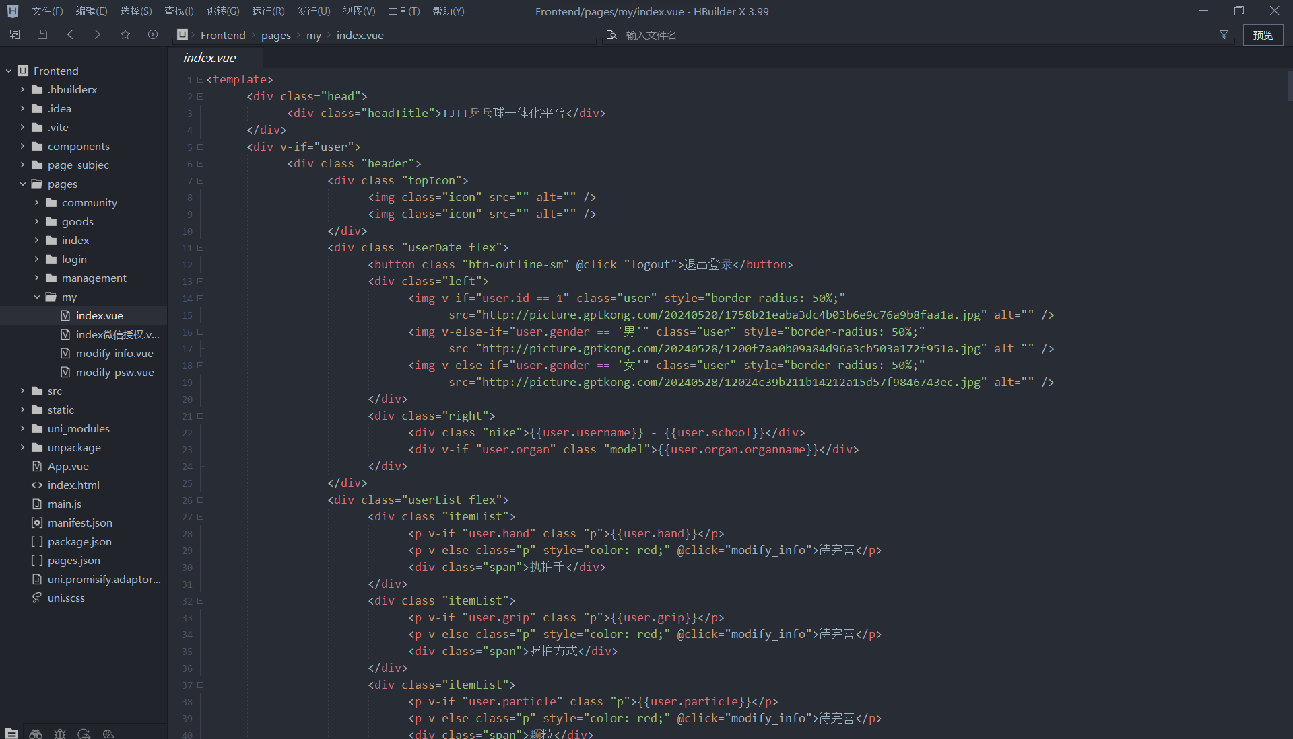
Technology Accomplishment
User Profile
View your personal information, ping pong skills and attributes, and account management tools all in one place.

Slide 5
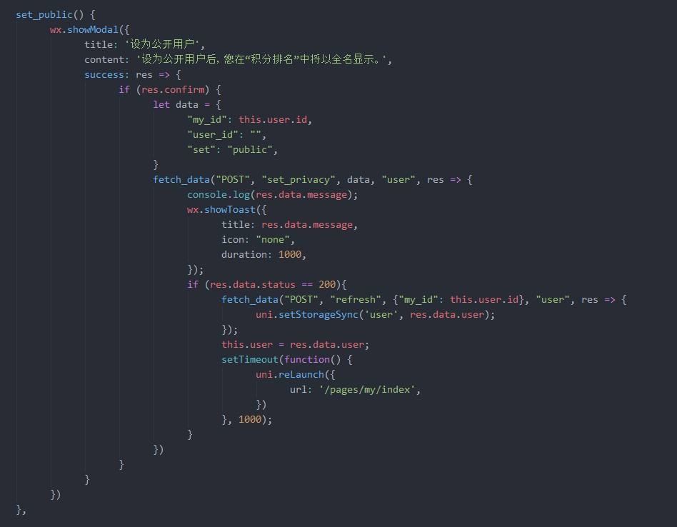
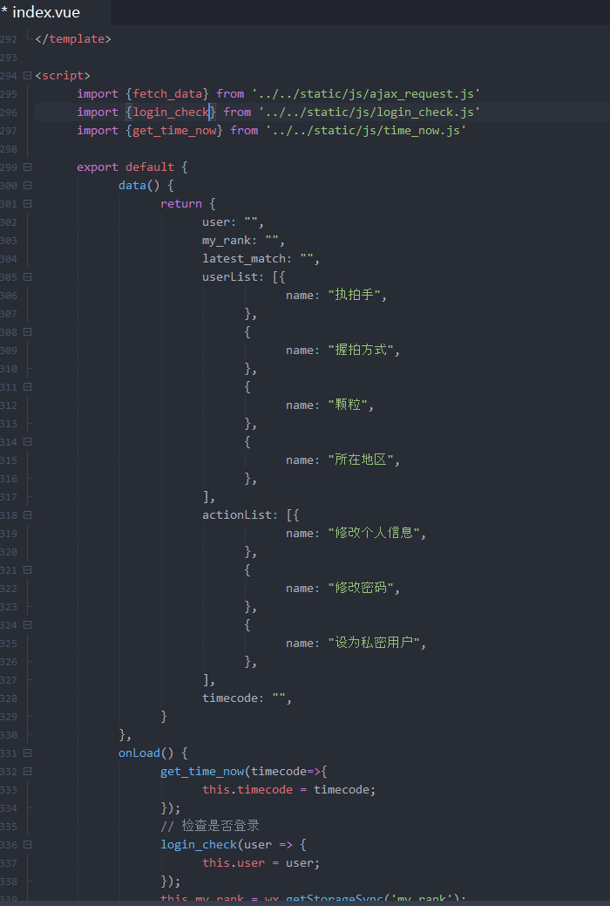
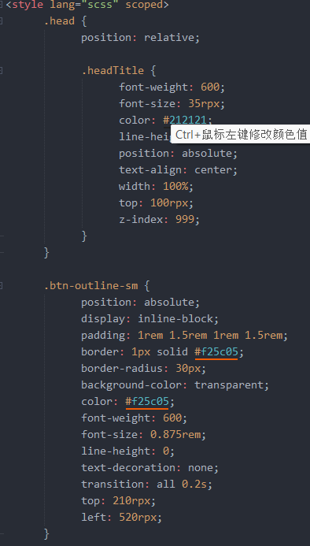
Technology
Accomplishment
User Profile
View your personal information, ping pong skills and attributes, and account management tools all in one place.

Slide 6
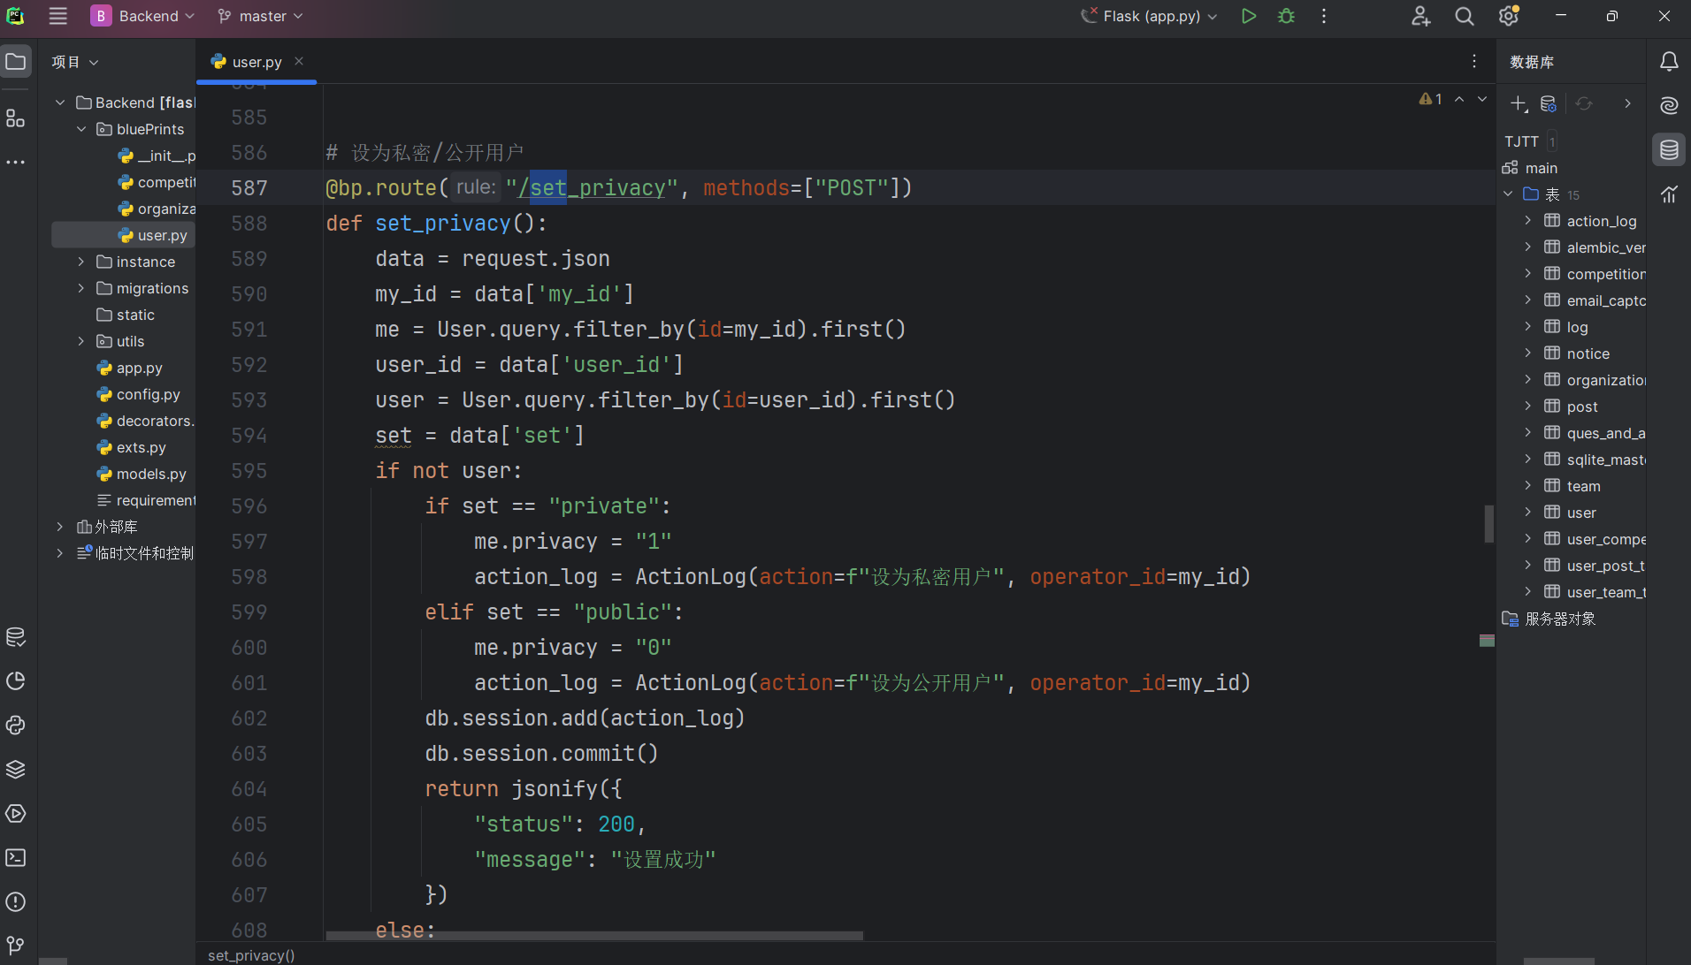
Technology Accomplishment
User Profile
View your personal information, ping pong skills and attributes, and account management tools all in one place.

Slide 7
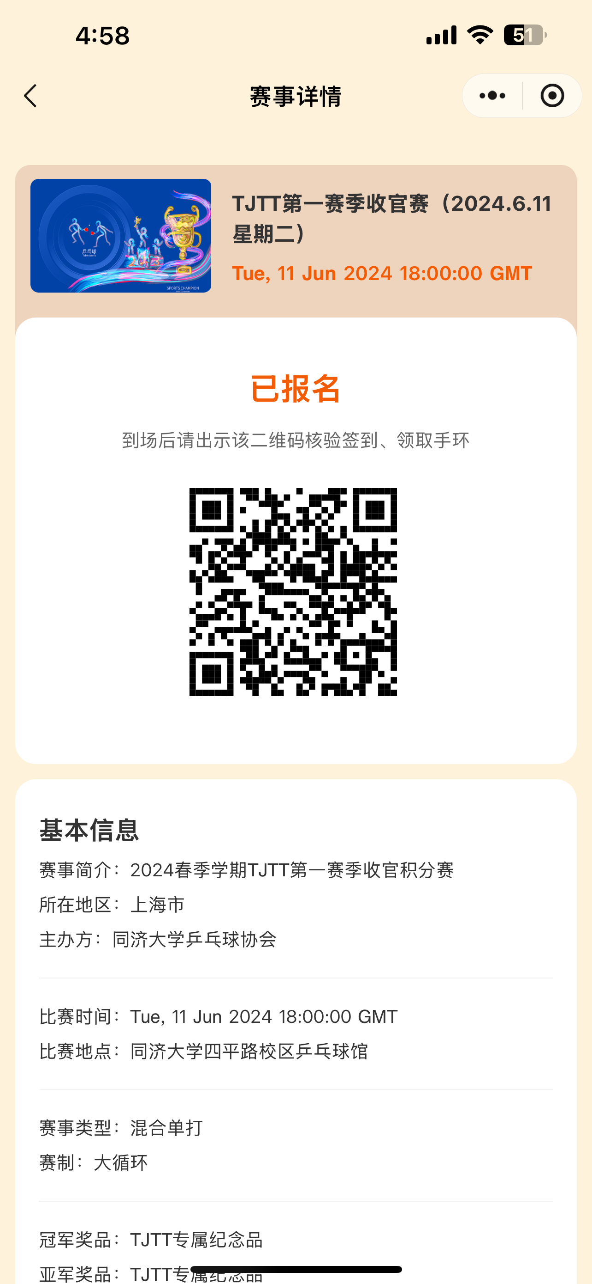
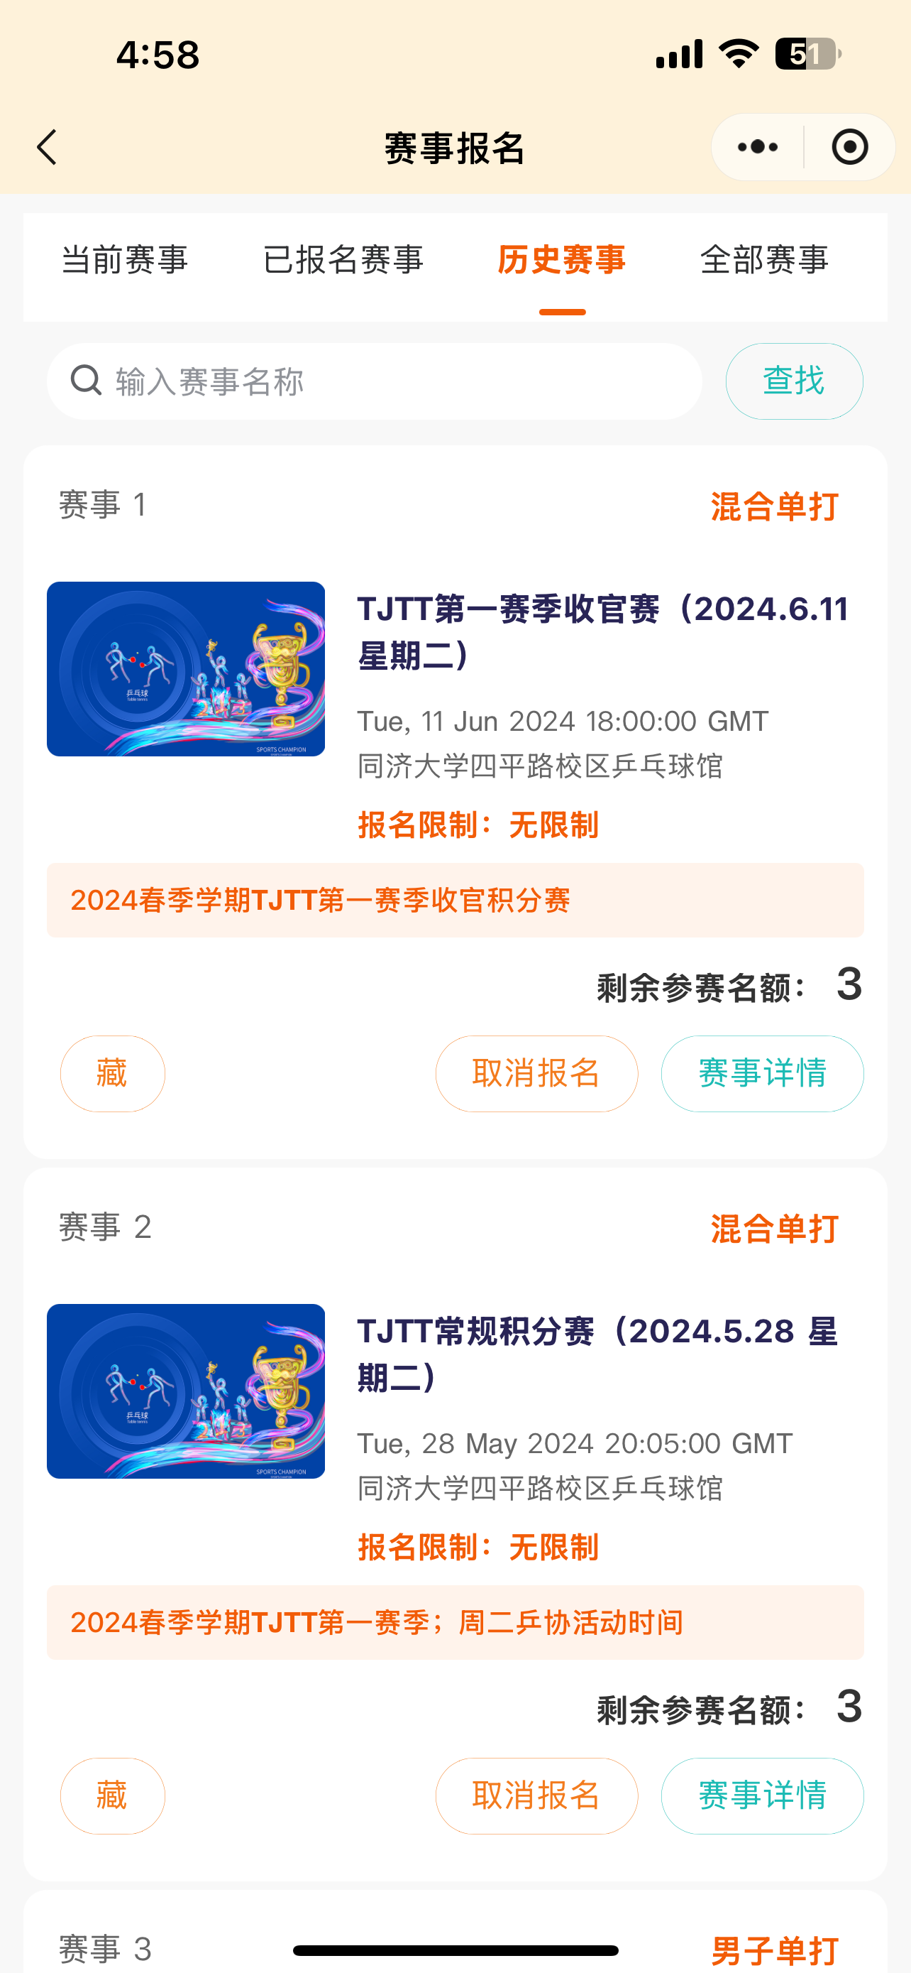
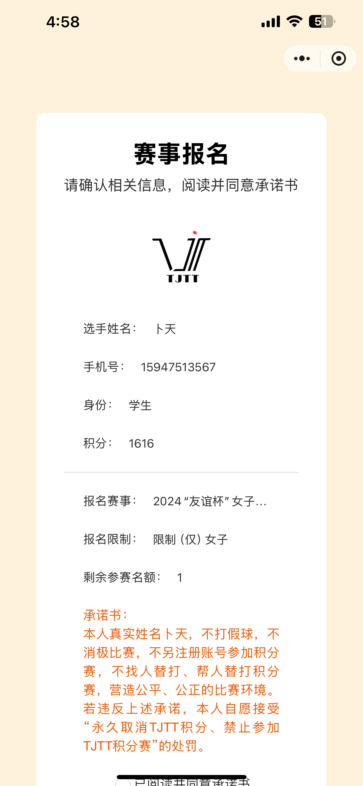
Seamless Event Management
Participation
Event Calendar
Check in with QR code for smooth event participation.
View current, upcoming, past, and all events.
1
2
3
Registration
Sign up and cancel registration for eligible events.

Slide 8
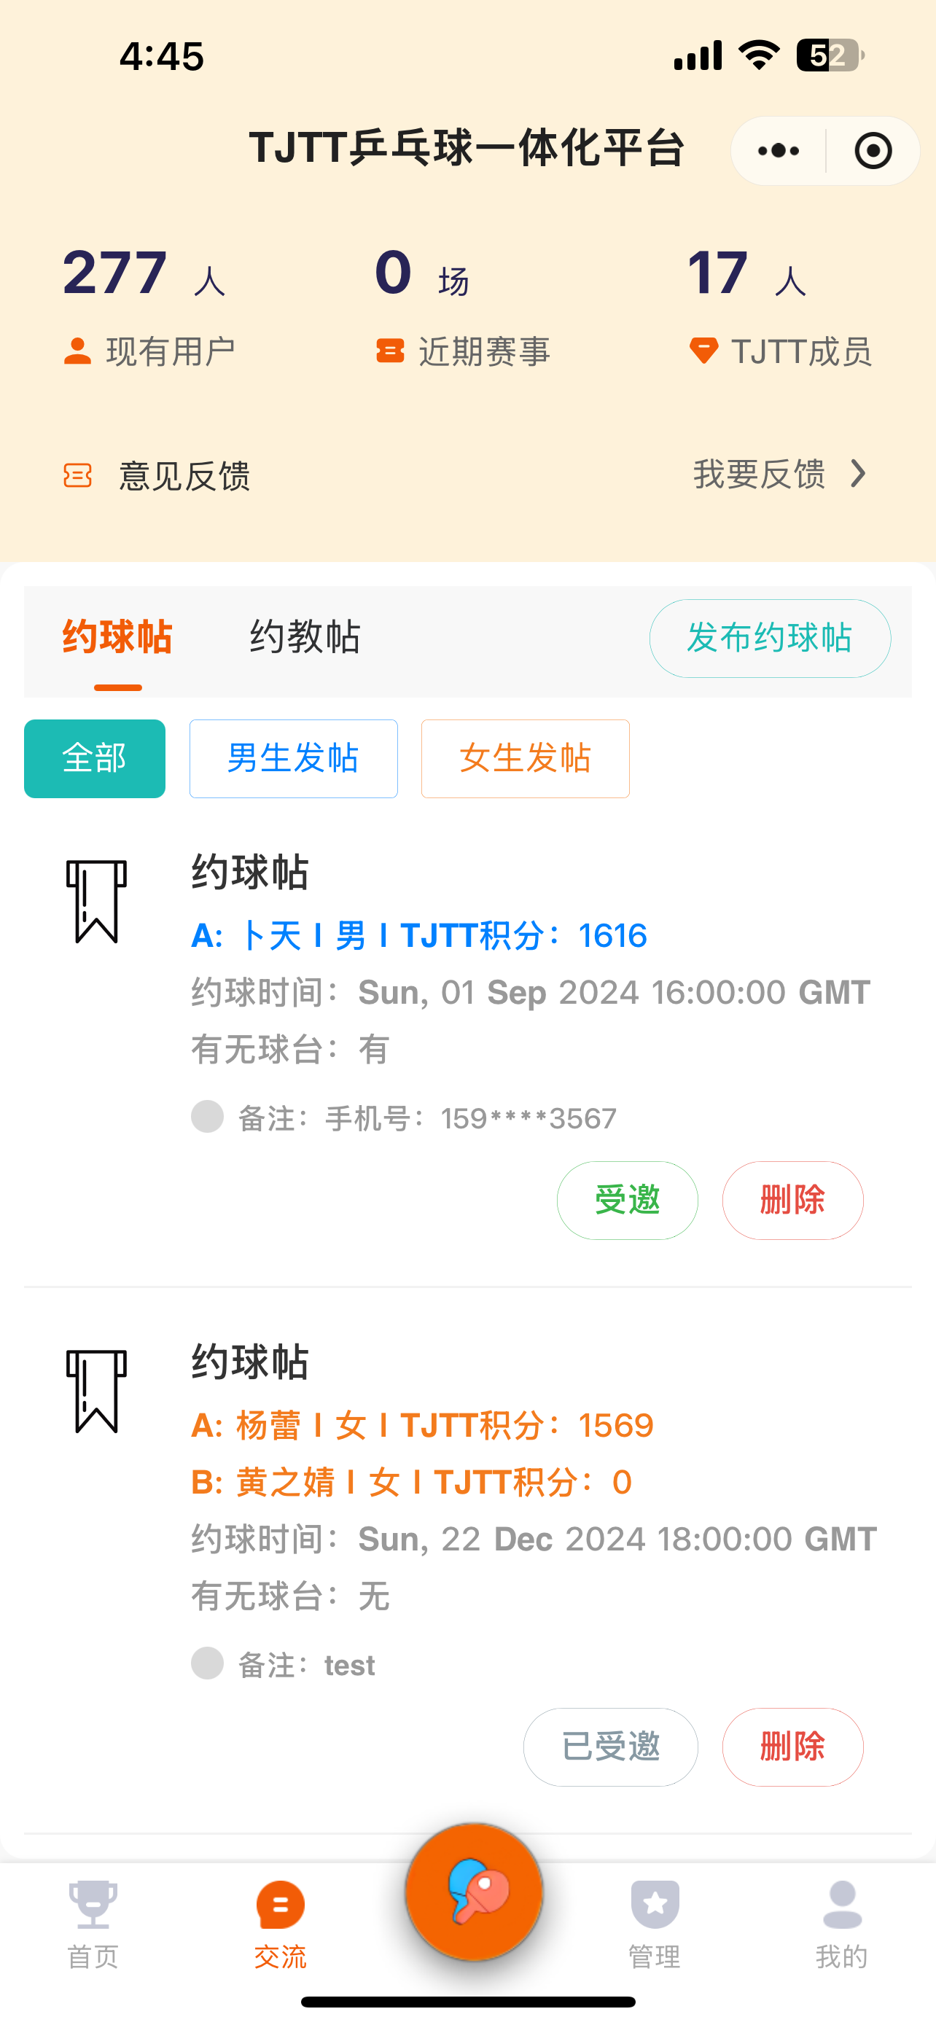



Social Ping Pong
Find Partners
Schedule Matches
Competitive Play
Easily connect with other players to arrange matches.
Coordinate schedules and reserve courts through the platform.
Participate in tournaments and track your performance.

Slide 9

Innovative and Impactful
Registered Users
277
Software Copyrights
2 pending
Patent Application
1 in progress

